Slide 1
Asymmetric Effects of Monetary Policy and Land Use Regulations on U.S. Housing Markets
Comments on:
Jeremy R. Groves, Ph.D., ACUE March 2026

Slide 2
Summary
Most homes in the United States are purchased with mortgages with rates related to the monetary policy of the Federal Reserve and FOMC.
While all cities (except for Houston, TX) are zoned, however, there is a large variation in the degree of restrictions.
This paper seeks to understand how changes in the Federal Funds rate impact the housing market and if these effects are symmetric and if they differ by land use restriction.
Estimates a PVAR model using GMM to estimate the impact on interest rates on housing price under different housing supply elasticities.

Slide 3
Findings
There is an inverse relationship between the PHI and the interest rates.
The size of the impact depends on regulation restrictiveness
Expansionary Policy: the positive impact on housing prices from a lower interest rate is larger in areas with more restrictive housing regulations.
Contractionary Policy: the negative impact on housing prices from a higher interest rate is larger in areas with more restrictive housing regulations.

Slide 4
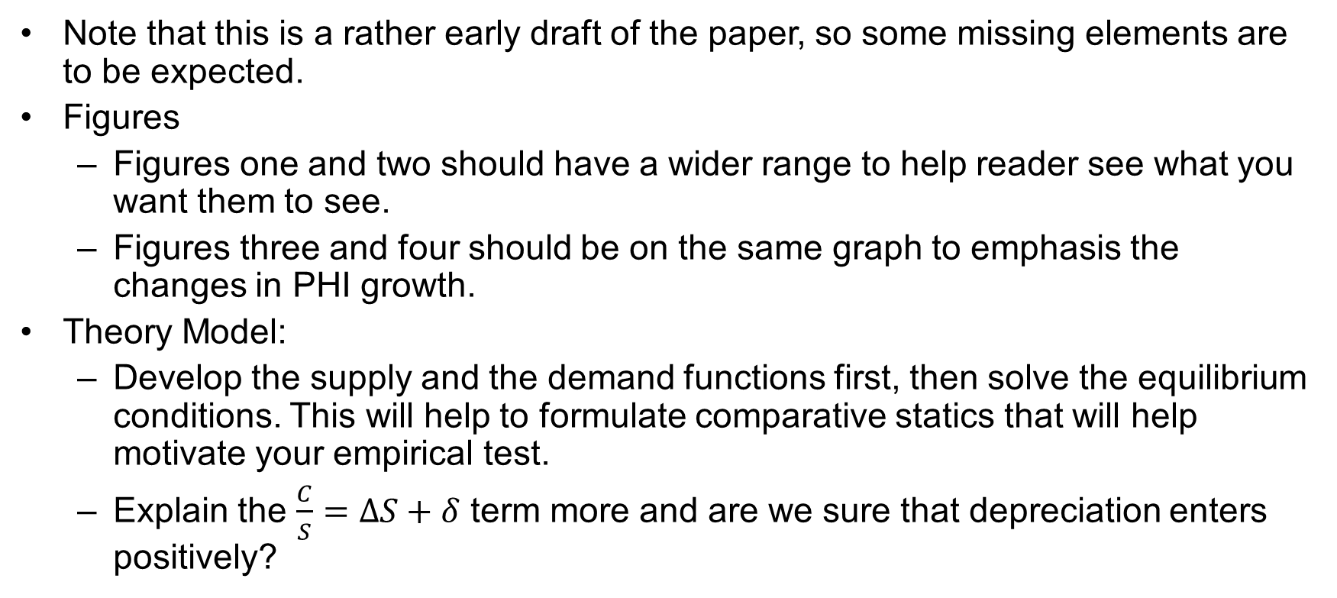
Comments
Note that this is a rather early draft of the paper, so some missing elements are to be expected.
Figures
Figures one and two should have a wider range to help reader see what you want them to see.
Figures three and four should be on the same graph to emphasis the changes in PHI growth.
Theory Model:
Develop the supply and the demand functions first, then solve the equilibrium conditions. This will help to formulate comparative statics that will help motivate your empirical test.
Explain the $\frac{C}{S}=ΔS+δ$ term more and are we sure that depreciation enters positively?

Slide 5
Comments
Data and Summary Statistics
This may just be rounding, but why is the PHI different between your two sub-samples?
Results
There seems to be a regional element to your restrictiveness and supply elasticity; could you also split your sample of some measure of urbanized space or undeveloped land? Land use regulations are generally in response to density issues and severe decreases in buildable area.
Match up your colors: Dark = Restrictive/Inelastic; Light = Loose/Elastic
How do interest rates impact the supply decision of developers? It seems you may have a classic “two-shifts” model.

